Slide 1
CSE4088 Introduction to Machine Learning Project Presentation
3D Object Detection using LiDAR Point Clouds
Onur Can Yücedağ – 150116825
Emre Erdem – 150115501
Alperen Bayraktar - 150116501

Slide 2
Overview of the project
Main Goals:
Research on the 3D object detection.
Understanding LiDAR Point Cloud data.
Implementation of a research project.
Understanding object detection pipelines.
Subtasks:
Getting system setup done.
Familiarizing with PyTorch.
Reading cutting-edge research papers in 3D object detection field.

Slide 3
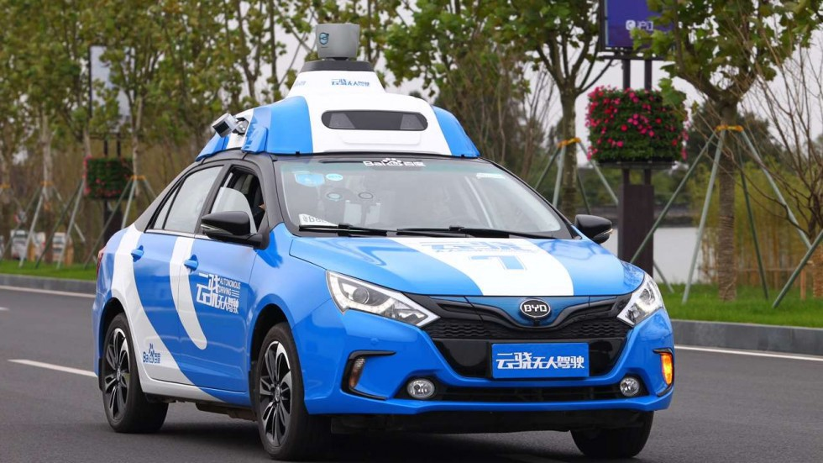
What is LiDAR ?

Slide 4
What is LiDAR - History
It was first used in 1960s after the introduction of laser.
LIDAR was used in space missions by NASA during 1970s.
In 1980s, LIDAR gained popularity because of the demand for GPS/IMU systems.
In topographic mapping, oceanography, agriculture, archaeology and in many fields LIDAR was used.

Slide 5
What is LiDAR
LiDAR stands for «Light Detection and Ranging».
LiDAR is a sensor which detects the range of a distant target.
Uses shorter wavelengths than radar which uses radio waves for measuring target.
Directly measures the 3D structures and underlying terrain with high resolution and accuracy.
Mainly used in construction, power transmission, transportation(Self-Driving Cars; except TESLA...), defense and aerospace.
Replaced photogrammetry in varius fields –because it is light independent.

Slide 6
What is Point Cloud Data?
Data structure that represents objects or space in 3D geometric coordinates. If there is a colour information, it becomes 4D.
Generated by 3D laser scanners like LiDAR. Used as a middleman to turn the raw data collected by LiDAR processes into 3D models.
Large scale library for processing point clouds; Point Cloud Library(PCL).
Many formats exist for representing point clouds.
Photogrammetric point clouds have an RGB value for each point, on the other hand LiDAR point clouds have XYZ and intensity values for each point.

Slide 7
What is Point Cloud Data ?

Slide 8
Which tasks can be acccomplished by LiDAR?
Self-Driving Cars Field:
3D Object Detection
3D Map Creation (ndt mapping algorithms)
SLAM(Simultaneous localization and mapping)
EGO Vehicle Localization(Mainly with GNSS fusion) ***
Simulation Asset Creation
Crash Avoidance***
Other fields:
Any situation where the structure and shape of Earth's surface needs to be known, and can even measure some gases and particles in the atmosphere.
Hazard assessment (including lava flows, landslides, tsunamis, and floods)
Forestry, agriculture, geologic mapping, and watershed and river surveys
Archeology and Building Construction

Slide 9
Object Detection in 2D
2D Object Detection:
Object boundaries in 2D space
Object class
Main researches:
YOLO
R-CNN
Fast R-CNN
SSD

Slide 10
3D Object Detection using LiDAR
3D Object Detection:
Object boundaries in 3D space
Object class
Main researches:
Point Pillars
PIXOR
MV3D
SECOND
HD-Net

Slide 11
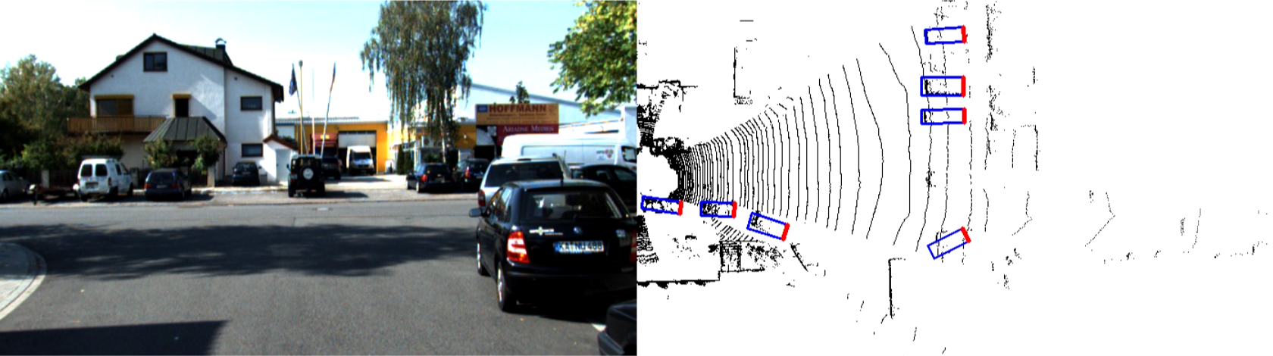
PIXOR
BEV representation of the point cloud.
Single stage detector to predict poses (SSD).

Slide 12
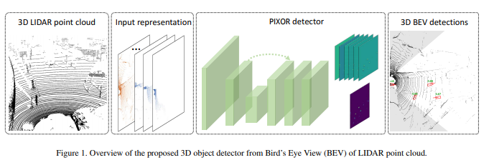
Technical Details
Bounding box estimates contains heading angle.
2D BEV representation of LiDAR point clouds with using occupancy and intensity as features in grid matrix.
Uses only 2D convolutions.
Uses direct encoding so we don’t need to set pre-defined anchors.
Backbone Network: Used for extracting the general representation of the input.
Header Network: Used to make task-spesific predictions, a score map representing the object class probability and the geometry maps(encodes size and shape of the 3D bounding box)

Slide 13
System Setup
Ubuntu 16.04
CUDA 10.0
ROS Kinetic
Python 3.5
PyTorch 1.1
Tensorboard
Velodyne Driver

Slide 14
Experiment
We experimented with the KITTI raw dataset indexed as: 2011_09_26_drive_0048 synced + rectified.
"synced+rectified" refers to the processed data where images have been rectified and undistorted and where the data frame numbers correspond across all sensor streams
3D Velodyne point clouds (100k points per frame stored as bineary float matrix)
Calibration
3D object tracklet labels.

Slide 15
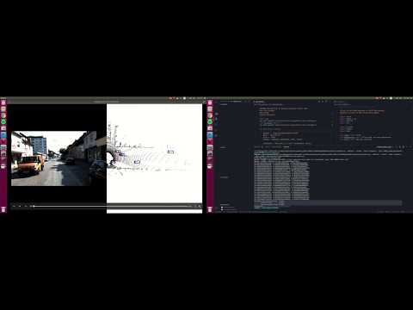
Demo

Slide 16
References
The KITTI Vision Benchmark Suite: http://www.cvlibs.net/datasets/kitti/raw_data.php
PIXOR: Real-time 3D Object Detection from Point Clouds: http://openaccess.thecvf.com/content_cvpr_2018/papers/Yang_PIXOR_Real-Time_3D_CVPR_2018_paper.pdf
philip-huang/PIXOR: https://github.com/philip-huang/PIXOR
What is Lidar and what is it used for?: https://www.americangeosciences.org/critical-issues/faq/what-lidar-and-what-it-used
What are the Top 5 Uses of LiDAR?: https://www.geospatialworld.net/blogs/top-5-uses-lidar-2/
The Point Cloud Library (PCL): http://www.pointclouds.org/
What are point clouds? 5 easy facts that explain point clouds: https://info.vercator.com/blog/what-are-point-clouds-5-easy-facts-that-explain-point-clouds

Slide 17

Thank you.

